Slide 1
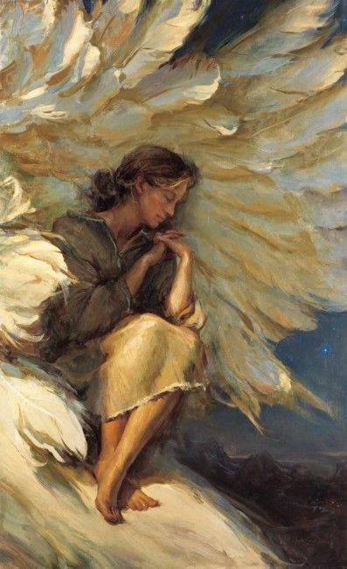
HIDDEN
ONES
God Calls
Us His

Slide 2
FOUNDATION OF THE REVELATION
They take shrewd counsel
against Your people,
and plot against
Your hidden ones.
(Psalms 83:3 MKJV)

Slide 3
OTHER TRANSLATIONS
His sheltered ones—NKJV
His precious ones—RBV
His treasured ones—NAS
His protected ones—RSV
From the Hebrew tsaphan = to hide by covering over

Slide 4
HIDDEN IN HIS PRESENCE
Oh, how great is Your goodness, which You have laid up for those who fear You, which You have prepared for those who trust in You in the presence of the sons of men! You shall hide them in the secret place of Your presence from the plots of man; You shall keep them secretly in a pavilion from the strife of tongues. (Psalms 31:19-20)

Slide 5
HIDDEN IN HIS TABERNACLE
One thing I have desired of the LORD, that will I seek: that I may dwell in the house of the LORD all the days of my life, to behold the beauty of the LORD, and to inquire in His temple. For in the time of trouble He shall hide me in His pavilion; in the secret place of His tabernacle He shall hide me; He shall set me high upon a rock. (Psalms 27:4-5)

Slide 6
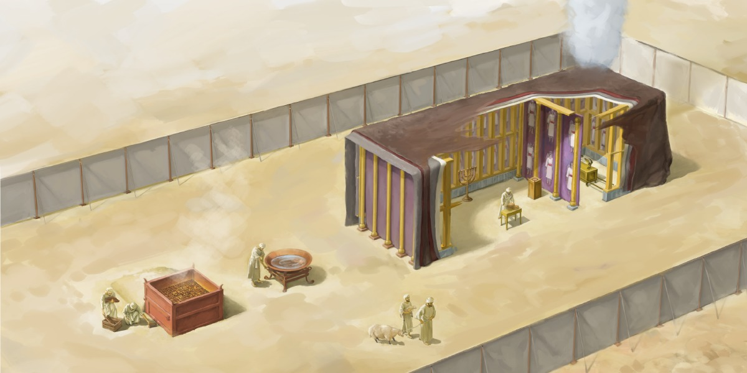
HIDDEN IN HIS TABERNACLE

Slide 7
A PLACE OF REFUGE
And there will be a tabernacle for shade in the daytime from the heat, for a place of refuge, and for a shelter from storm and rain.
(Isaiah 4:6)

Slide 8
A SHADY PLACE
Behold, He who keeps Israel
shall neither slumber nor sleep.
The LORD is your keeper; the LORD is your shade at your right hand. (Psalms 121:4-5)

Slide 9
A HIDING PLACE FROM THE WIND
Behold, a king will reign in righteousness, and princes will rule with justice.
A man will be as a hiding place from the wind, and a cover from the tempest, as rivers of water in a dry place, as the shadow of a great rock in a weary land.
(Isaiah 32:1-2)

Slide 10
JESUS IS THAT TABERNACLE
And I heard a loud voice from heaven saying, “Behold, the tabernacle of God is with men, and He will dwell with them, and they shall be His people. God Himself will be with them and be their God.”
(Revelation 21:3)

Slide 11
HIDDEN UNDER HIS WINGS
Be merciful to me, O God, be merciful to me! For my soul trusts in You; and in the shadow of Your wings I will make my refuge, until these calamities have passed by. (Psalms 57:1)

Slide 12
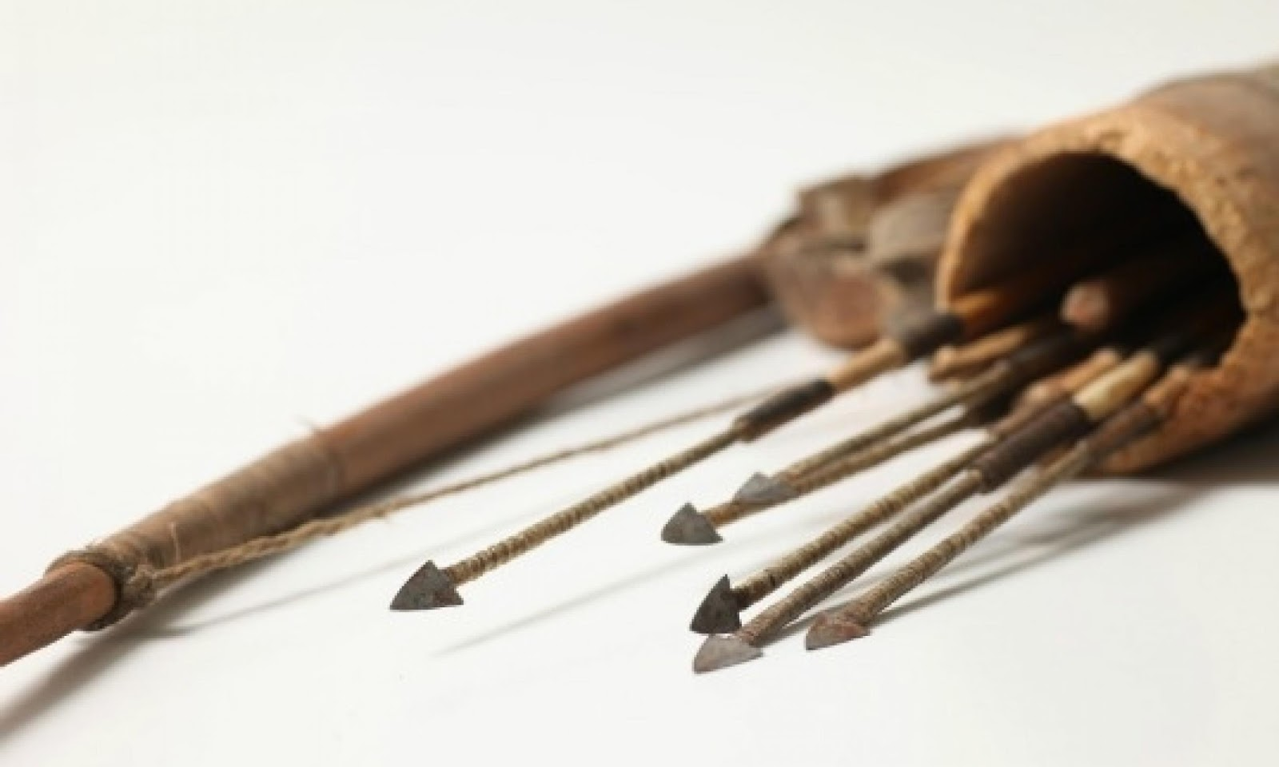
HIDDEN IN HIS HAND & QUIVER
And He has made My mouth like a sharp sword; in the shadow of His hand He has hidden
Me, and made Me a
polished shaft; in
His quiver He has
hidden Me.
(Isaiah 49:2)

Slide 13
HIDDEN WITH CHRIST IN GOD
Set your mind on things above, not on things on the earth. For you died, and your life is hidden with Christ in God.
(Colossians 3:2-3)

Slide 14
THE LAST DAYS PROMISE
Seek the LORD, all you meek of the earth, who have upheld His justice. Seek righteousness, seek humility. It may be that you will be hidden in the day of the LORD's anger.
(Zephaniah 2:3)

