Slide 1

SEVEN PRAYERS FOR REVIVAL!!!!!!!
To raise us from death to life

Slide 2
The High and Holy Place
For thus says the High and Lofty One who inhabits eternity, whose name is Holy: “I dwell in the high and holy place, with him who has a contrite and humble spirit, to revive the spirit of the humble, and to revive the heart of the contrite ones.” (Is. 57:15)

Slide 3
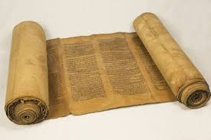
God’s Word
My soul clings to the dust; revive me according to Your Word.
(Psalms 119:25)

Slide 4
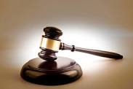
God’s Judgments
Great are Your tender mercies, O LORD; revive me according to Your judgments.
(Psalms 119:156, see Zeph. 3:15)

Slide 5

God’s Way
Turn away my eyes from looking at worthless things, and revive me in Your way.
(Psalms 119:37)

Slide 6

God’s Love
Revive me according to Your lovingkindness, so that I may keep the testimony of Your mouth.
(Psalms 119:88)

Slide 7
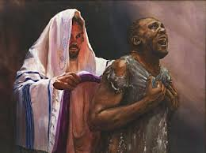
Righteousness
Behold, I long for Your precepts; Revive me in Your righteousness.
(Psalms 119:40)

Slide 8
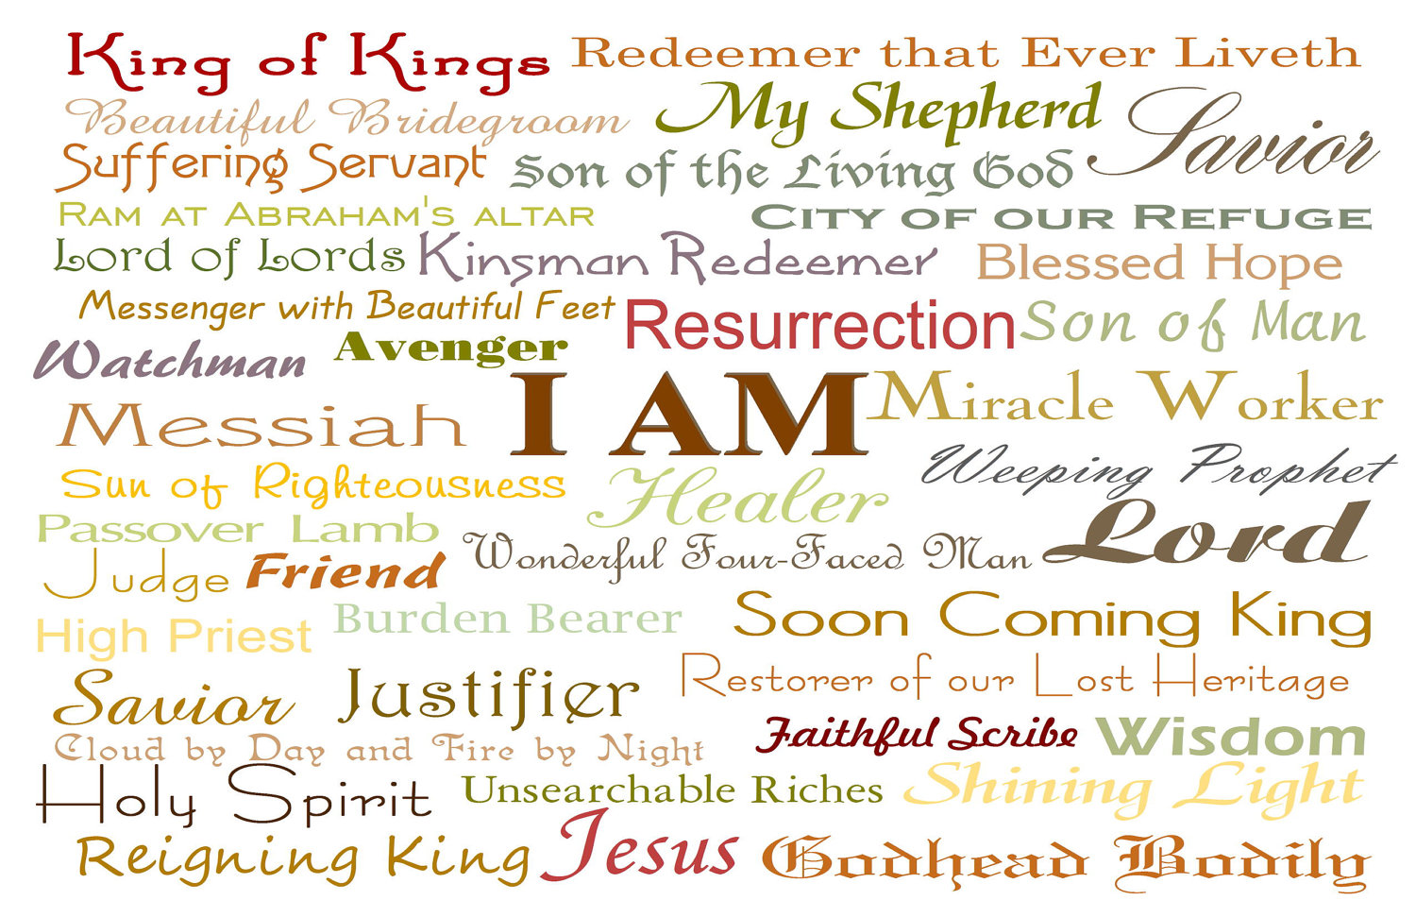
His Name
Revive me, O LORD, for Your name's sake! For Your righteous-ness' sake bring my soul out of trouble.
(Psalms 143:11)

Slide 9

His Praise
Will You not revive us again, that Your people may rejoice in You?
(Psalms 85:6)

